Slide 1


Unpacking ERP Responses in Artificial Language Learning Pablo Bernabeu in collaboration with Christina Athanasiadi, Gabriella Silva, Stella Pischinger, My Ngoc Giang Hoang, Vincent deLuca, Jason Rothman, Claudia Poch, Iva Ivanova, Jorge González Alonso
LaBL

Slide 2
Morphosyntactic transfer
Initial heuristics
Cognitive economy
Facilitative or non-facilitative

Slide 3
Morphosyntactic transfer
Initial heuristics
Cognitive economy
Facilitative or non-facilitative
Third language (L3) context
transfer source(s) selected
information guiding the selection
time course of the selection

Slide 4
Morphosyntactic transfer
Initial heuristics
Cognitive economy
Facilitative or non-facilitative
Third language (L3) context
transfer source(s) selected
information guiding the selection
time course of the selection
LESS Project
Linguistic Economy through
transfer Source Selectivity

Slide 5
Transfer in L3 acquisition
Sources

Slide 6
Transfer in L3 acquisition
Sources
L2 by default
L1 and/or L2

Slide 7
Transfer in L3 acquisition
Sources
L2 by default
L2 Status Factor Model (Bardel & Falk, 2012)
L2 by default. Declarative memory for L2 and subsequent languages
L1 and/or L2

Slide 8
Transfer in L3 acquisition
Sources
L2 by default
L2 Status Factor Model (Bardel & Falk, 2012)
L2 by default. Declarative memory for L2 and subsequent languages
Cumulative Enhancement Model (Flynn, Foley & Vinnitskaya, 2004)
Property-by-property and only facilitative
L1 and/or L2

Slide 9
Transfer in L3 acquisition
Sources
L2 by default
L2 Status Factor Model (Bardel & Falk, 2012)
L2 by default. Declarative memory for L2 and subsequent languages
Cumulative Enhancement Model (Flynn, Foley & Vinnitskaya, 2004)
Property-by-property and only facilitative
Linguistic Proximity Model (Westergaard et al., 2017)
Property-by-property, with facilitative and non-facilitative outcomes
L1 and/or L2

Slide 10
Transfer in L3 acquisition
Sources
L2 by default
L2 Status Factor Model (Bardel & Falk, 2012)
L2 by default. Declarative memory for L2 and subsequent languages
Cumulative Enhancement Model (Flynn, Foley & Vinnitskaya, 2004)
Property-by-property and only facilitative
Linguistic Proximity Model (Westergaard et al., 2017)
Property-by-property, with facilitative and non-facilitative cases
Typological Primacy Model (Rothman, 2011)
Full transfer from one language, based on overall structural similarity
L1 and/or L2

Slide 11
Morphosyntactic transfer in L3 acquisition

Slide 12
Morphosyntactic transfer in L3 acquisition
Confounds when using natural languages: age of acquisition, frequency of use, proficiency level, morphological salience, etc.

Slide 13
Morphosyntactic transfer in L3 acquisition
Confounds when using natural languages: age of acquisition, frequency of use, proficiency level, morphological salience, etc.
Workaround: artificial languages
Consistency with natural language
Acquired by statistical learning (Hudson et al., 2005; Kidd, 2012; Monaghan et al., 2023)
Similar processing signatures (Friederici et al., 2002; Uddén & Männel, 2018)

Slide 14
Morphosyntactic transfer in L3 acquisition
Confounds when using natural languages: age of acquisition, frequency of use, proficiency level, morphological salience, etc.
Workaround: artificial languages
Consistency with natural language
Acquired by statistical learning (Hudson et al., 2005; Kidd, 2012; Monaghan et al., 2023)
Similar processing signatures (Friederici et al., 2002; Uddén & Männel, 2018)
An extensive training in the artificial language could be necessary for standard syntactic signatures (notably, P600) to appear in ERPs (González Alonso et al., 2020; Pereira Soares et al., 2022).

Slide 15
González Alonso et al. (2020)
Participants: L1 Spanish, L2 English
Artificial language groups: Mini-Spanish (n = 26), Mini-English (n = 24)
Grammatical property: gender agreement between nouns and predicative adjectives in copular sentences. Example:
Mini-Spanish: Jer mochil son carejur | Jer mochil son baratejur
Mini-English: Jer bag are expensivejur | Jer bag are cheapejur
Translation: The bags are expensive | The bags are cheap
Session phases: vocabulary pre-training → grammatical training → test (min. 80%) → ERP experiment → gender assignment task in Spanish

Slide 16
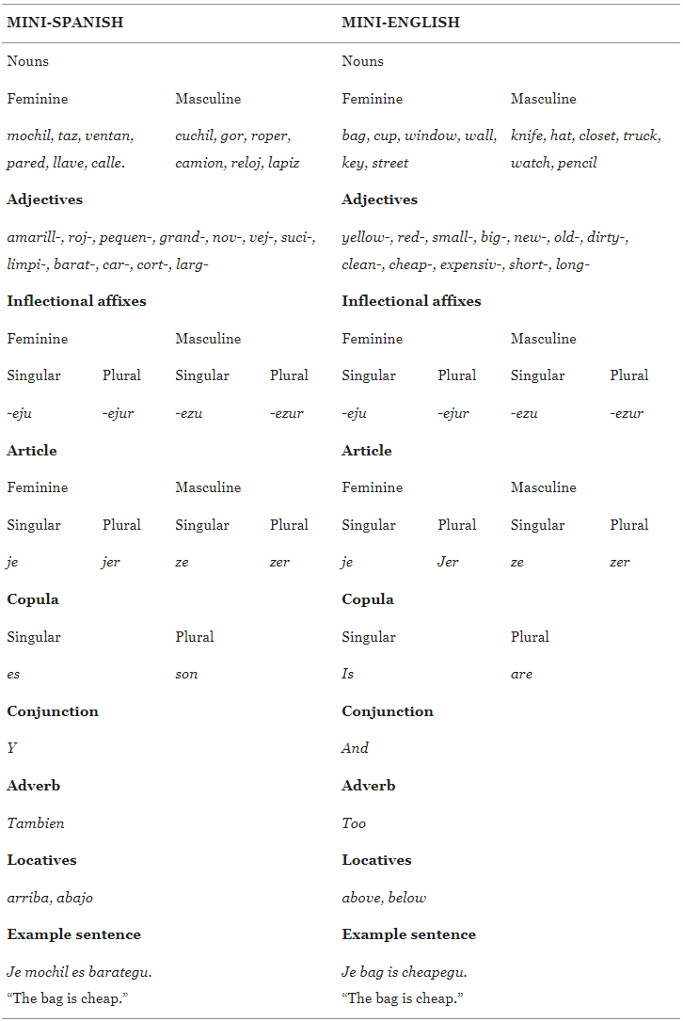
González Alonso et al. (2020)
Nouns
Nouns
Artificial languages
Je bag is cheapeju

Slide 17
González Alonso et al. (2020)
Pre-training

Slide 18
González Alonso et al. (2020)
Training

Slide 19
González Alonso et al. (2020)
Test

Slide 20
González Alonso et al. (2020)
Experiment

Slide 21
González Alonso et al. (2020)
Gender assignment
task in Spanish

Slide 22
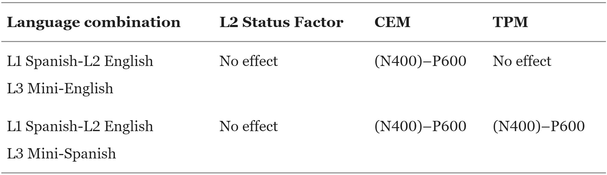
González Alonso et al. (2020)
Hypotheses (based on Rothman et al., 2015) under the assumption that transfer would happen before the ERP measurement.

Slide 23
González Alonso et al. (2020)
Results
Mini-Spanish group: broadly distributed 300–600 ms positivity, most consistent with attention-related P300.
No (N400)–P600
Interpretation: allocation of attentional resources in preparation for the selection of transfer source(s). In Mini-Spanish, larger focus on word-final gender morphology, consistent with Spanish.

Slide 24
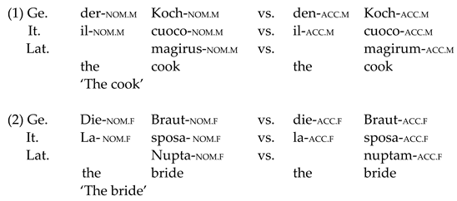
Pereira Soares et al. (2022)
Materials

Slide 25
Pereira Soares et al. (2022)
Hypotheses (based on Rothman et al., 2015) under the assumption that transfer would happen before the ERP measurement.
 | Case morphology |  | Adjective position
Language combination | TPM | LPM/SM | TPM | LPM/SM
L1 Italian—L1 German (L2 English)—L3 Mini-Latin | No effect | (N400)-P600 | (N400)-P600 | (N400)-P600
L1 German—L2 English—L3 Mini-Latin | No effect | (N400)-P600 | No effect | No effect

Slide 26
Pereira Soares et al. (2022)
Results
From the abstract: […] “N200/N400 deflection for the HSs in case morphology and a P600 effect for the German L2 group in adjectival position. None of the current L3/Ln models predict the observed results, which questions the appropriateness of this methodology.”

Slide 27
Our study
Sites: Tromsø and Madrid
Several groups per site
Six sessions
Three executive functions
Three grammatical properties
Several parts per session

Slide 28

Grammatical properties, examples, and presence in natural languages
Gender agreement | Zer watch are yellowezur and …
in Spanish and Norwegian
Differential object marking | Jessica provided ze fikey and …
in Spanish
Verb-object number agreement | John cleanedevo zer fikey and…
in none of these languages

Slide 29

Wrap-up buffer: … and ze watch too
Sentence wrap-up effects: Real? Dogma? Real?
Just and Carpenter (1980)
Stowe et al. (2018)
Desbordes et al. (2023)
Meister et al. (2022)

Slide 30
Property | Artificial lang.
Gender agreement | Mini-Norwegian
 | Mini-English
Differential object marking | Mini-Norwegian
 | Mini-English
Verb-object number agreem. | Mini-Norwegian
 | Mini-English
Property | Group | Artificial lang.
Gender agreement | L1 Eng, L2 Spa | Mini-Spanish
 | L1 Eng L2 Sp | Mini-English
 | L1 Spa, L2 Eng | Mini-Spanish
 | L1 Sp L2 Eng | Mini-English
Differential object marking | L1 Eng, L2 Spa | Mini-Spanish
 | L1 Eng L2 Sp | Mini-English
 | L1 Spa, L2 Eng | Mini-Spanish
 | L1 Sp L2 Eng | Mini-English
Verb-object number agreement | L1 Eng, L2 Spa | Mini-Spanish
 | L1 Eng L2 Sp | Mini-English
 | L1 Spa, L2 Eng | Mini-Spanish
 | L1 Sp L2 Eng | Mini-English

Slide 31
Sessions
Session 1. Individual differences (home-based session)
Working memory (digit span), selective attention (Stroop) and implicit learning (serial reaction time)
Language History Questionnaire (LHQ3; Li et al., 2020)

Slide 32
Sessions
Session 1. Individual differences (home-based session)
Working memory (digit span), selective attention (Stroop) and implicit learning (serial reaction time)
Language History Questionnaire (LHQ3; Li et al., 2020)
+ 1 week: Session 2. Gender agreement
Session begins with resting-state EEG (eyes-open, eyes-closed counterbalanced across participants)

Slide 33
Sessions
Session 1. Individual differences (home-based session)
Working memory (digit span), selective attention (Stroop) and implicit learning (serial reaction time)
Language History Questionnaire (LHQ3; Li et al., 2020)
+ 1 week: Session 2. Gender agreement
Session begins with resting-state EEG (eyes-open, eyes-closed counterbalanced across participants)
+ 1 week: Session 3. Differential object marking + Gender agreement
Training only in the new property
Experiment part contains both properties intermixed

Slide 34
Sessions
Session 1. Individual differences (home-based session)
Working memory (digit span), selective attention (Stroop) and implicit learning (serial reaction time)
Language History Questionnaire (LHQ3; Li et al., 2020)
+ 1 week: Session 2. Gender agreement
Session begins with resting-state EEG (eyes-open, eyes-closed counterbalanced across participants)
+ 1 week: Session 3. Differential object marking + Gender agreement
Training only in the new property
Experiment part contains both properties intermixed
+ 1 week: Session 4. Verb-object agreement + Differential object marking + Gender agreement
Same mechanism as in the previous session
Session ends with resting-state EEG (eyes-open, eyes-closed counterbalanced across participants)

Slide 35
Sessions
Session 1. Individual differences (home-based session)
Working memory (digit span), selective attention (Stroop) and implicit learning (serial reaction time)
Language History Questionnaire (LHQ3; Li et al., 2020)
+ 1 week: Session 2. Gender agreement
Session begins with resting-state EEG (eyes-open, eyes-closed counterbalanced across participants)
+ 1 week: Session 3. Differential object marking + Gender agreement
Training only in the new property
Experiment part contains both properties intermixed
+ 1 week: Session 4. Verb-object agreement + Differential object marking + Gender agreement
Same mechanism as in the previous session
Session ends with resting-state EEG (eyes-open, eyes-closed counterbalanced across participants)
+ 1 week: Session 5. Retest of executive functions (home-based session)

Slide 36
Sessions
Session 1. Individual differences (home-based session)
Working memory (digit span), selective attention (Stroop) and implicit learning (serial reaction time)
Language History Questionnaire (LHQ3; Li et al., 2020)
+ 1 week: Session 2. Gender agreement
Session begins with resting-state EEG (eyes-open, eyes-closed counterbalanced across participants)
+ 1 week: Session 3. Differential object marking + Gender agreement
Training only in the new property
Experiment part contains both properties intermixed
+ 1 week: Session 4. Verb-object agreement + Differential object marking + Gender agreement
Same mechanism as in the previous session
Session ends with resting-state EEG (eyes-open, eyes-closed counterbalanced across participants)
+ 1 week: Session 5. Retest of executive functions (home-based session)
+ 4 months: Session 6. Retest of all grammatical properties
Session ends with control tests on the relevant properties in the natural languages

Slide 37
Creation of the artificial languages
No cognates
Content words (n, adj, adv, v): translated across the two artificial languages in each site, and ideally across the three mini-languages.
Must be picturable
Morphemes: same across the two artificial languages in each site, and ideally across the three mini-languages.
Adjectives: paired by meaning, mostly by antonymy.

Slide 38
Stimulus creation: Phonological and semantic challenges
SPA_noun | ENG_noun | NOR_noun
habitación | bedroom | soverom
mochil | bag | bag
nuez | walnut | valnøtt
perch | hanger | henger
raiz | root | rot
taz | cup | kopp
ventan | window | vindu
aguacate | avocado | avokado
cuchil | knife | kniv
gor | hat | hatt
reloj | watch | klokke
zapat | shoe | sko
malet | suitcase | koffert
mes | table | bord
etiquet | label | merkelapp
blue | blaa
white | hvit
first | foerst
last | sist
good | bra
bad | daarlig
easy | lett

Slide 39
Creation of the artificial languages
Modular framework formed of interoperable components
Minimal components of each language contained in a base file
Linguistic and visual stimuli finally presented are created by assembling minimal components.
Several controls exerted on the stimuli to prevent spurious effects. For instance, gender and number are counterbalanced across experimental conditions. Similarly, words and experimental conditions within the same set appear equally often.

Slide 40
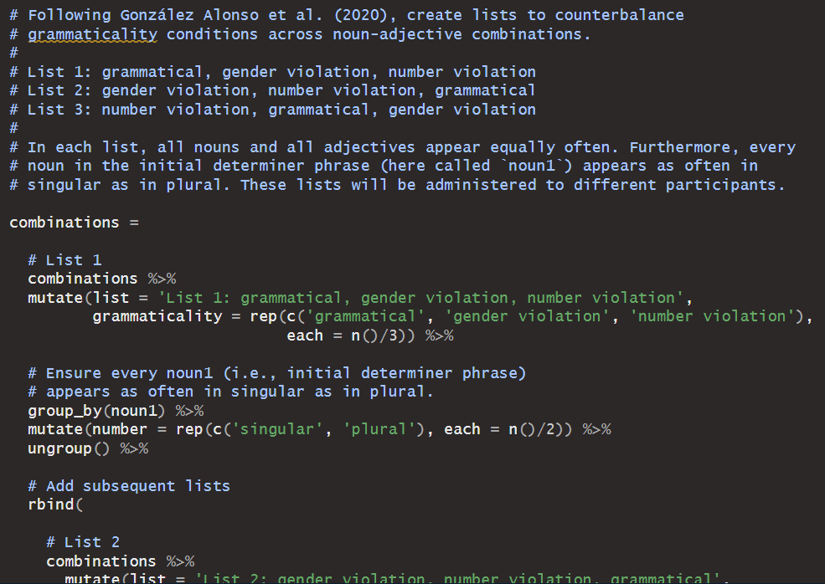

Slide 41
Creation of the artificial languages
Modular framework formed of interoperable components
Minimal components of each language contained in a base file
Linguistic and visual stimuli finally presented are created by assembling minimal components.
Several controls exerted on the stimuli to prevent spurious effects. For instance, gender and number are counterbalanced across experimental conditions. Similarly, words and experimental conditions within the same set appear equally often.
All stimuli compiled through R scripts

Slide 42
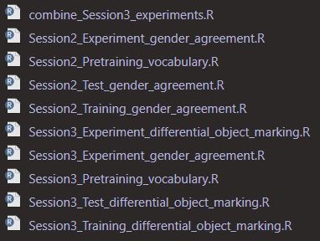
All scripts are run from a core script.

Slide 43
Creation of the artificial languages
Modular framework formed of interoperable components
Minimal components of each language contained in a base file
Linguistic and visual stimuli finally presented are created by assembling minimal components.
Several controls exerted on the stimuli to prevent spurious effects. For instance, gender and number are counterbalanced across experimental conditions. Similarly, words and experimental conditions within the same set appear equally often.
All stimuli compiled through R scripts
Present framework facilitates reproducibility and inspection of stimuli, and allows extensions
Parallel lists of stimuli used to enable some of the controls
Open-source software OpenSesame used to present the stimuli and collect responses

Slide 44

Stimuli ahead
Example of stimuli presented next include different mini-languages.
Mini-languages were distributed between groups. Each participant only saw one mini-language.

Slide 45
Gender agreement
Introduced, trained on and tested on in Session 2
Maintained across subsequent sessions

Slide 46
Training in gender agreement

Slide 47
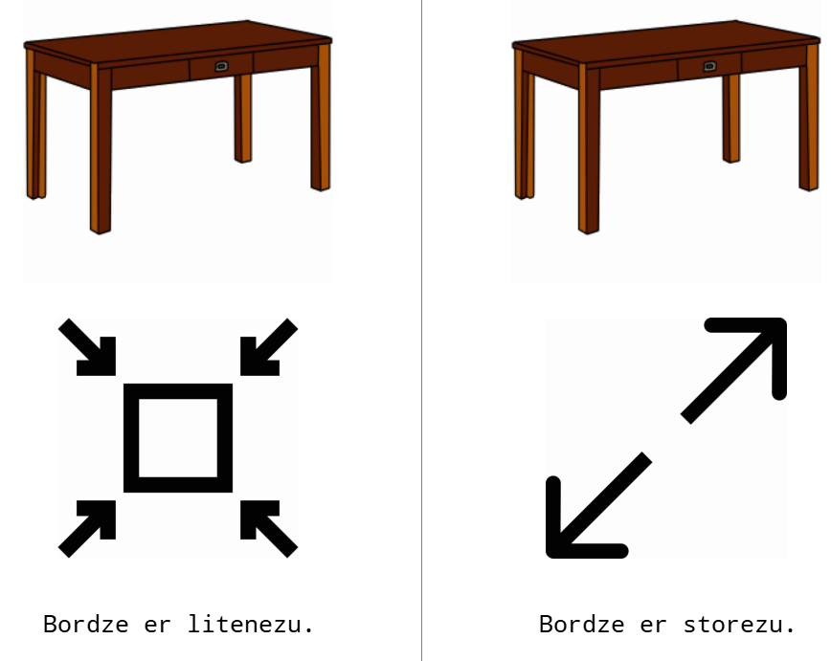
Training in gender agreement

Slide 48
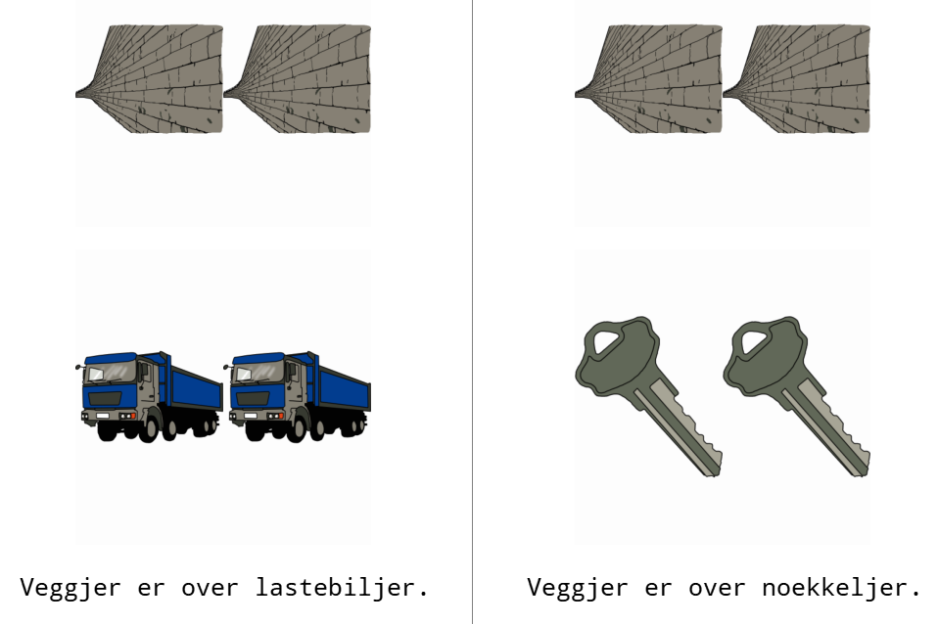
Locative filler during training

Slide 49
Test on gender agreement - Session 2 Match image to one of five sentences
1. Correct
2. Gender agreement violation
3. Number agreement violation
4. Gender and number agreement violation
5. Semantic violation (i.e., opposite adjective)

Slide 50


Slide 51
Differential object marking
Introduced, trained on and tested on in Session 3
Maintained across subsequent sessions

Slide 52
Training in differential object marking

Slide 53
Locative filler during training

Slide 54
Test on differential object marking - Session 3 Match image to one of five sentences
1. Correct
2. DOM violation (i.e., object noun without DOM)
3. Article with number violation
4. Misplaced article
5. Noun with semantic violation (i.e., noun different from image)

Slide 56
Verb-object number agreement

Slide 57
Training in verb-object number agreement

Slide 58
Test on verb-object number agreement

Slide 59
Examples of conditions of interest
zer watch are yellowejur and zer pencil too Gender agreement violation
Jessica chose fi je street and fi ze roof too. Correct differential object marking
Thomas chose je key but not je backpack. Violation of differential object
marking (missing fi)
∅
∅

Slide 60
Examples of control conditions
zer watch are yellowezu and zer pencil too Number violation (missing r)
Jessica provided fi zekey and fi zewall too Article misplacement
Ole bestilte fi jevegg og fi zetak ogsaa. Article misplacement
∅

Slide 61
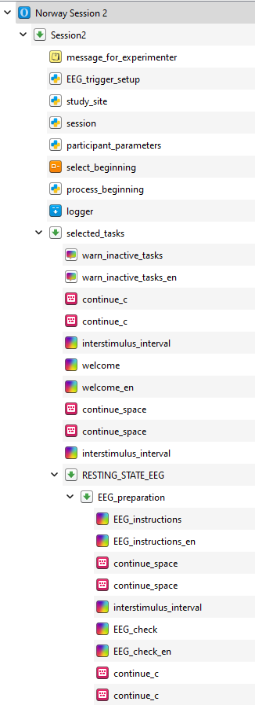
Lab sessions
Instructions written in the language corresponding to each artificial language group (e.g., in Norwegian for the Mini-Norwegian group).
Sufficient written instructions to avoid linguistic influence through spoken explanations.

Slide 62
Preliminary results
~ 23 participants per mini-language group by Session 5
~ 11 participants per mini-language group by Session 6
- Data collection will continue over the next few months.

Slide 63
Accuracy of grammaticality judgements

Slide 64
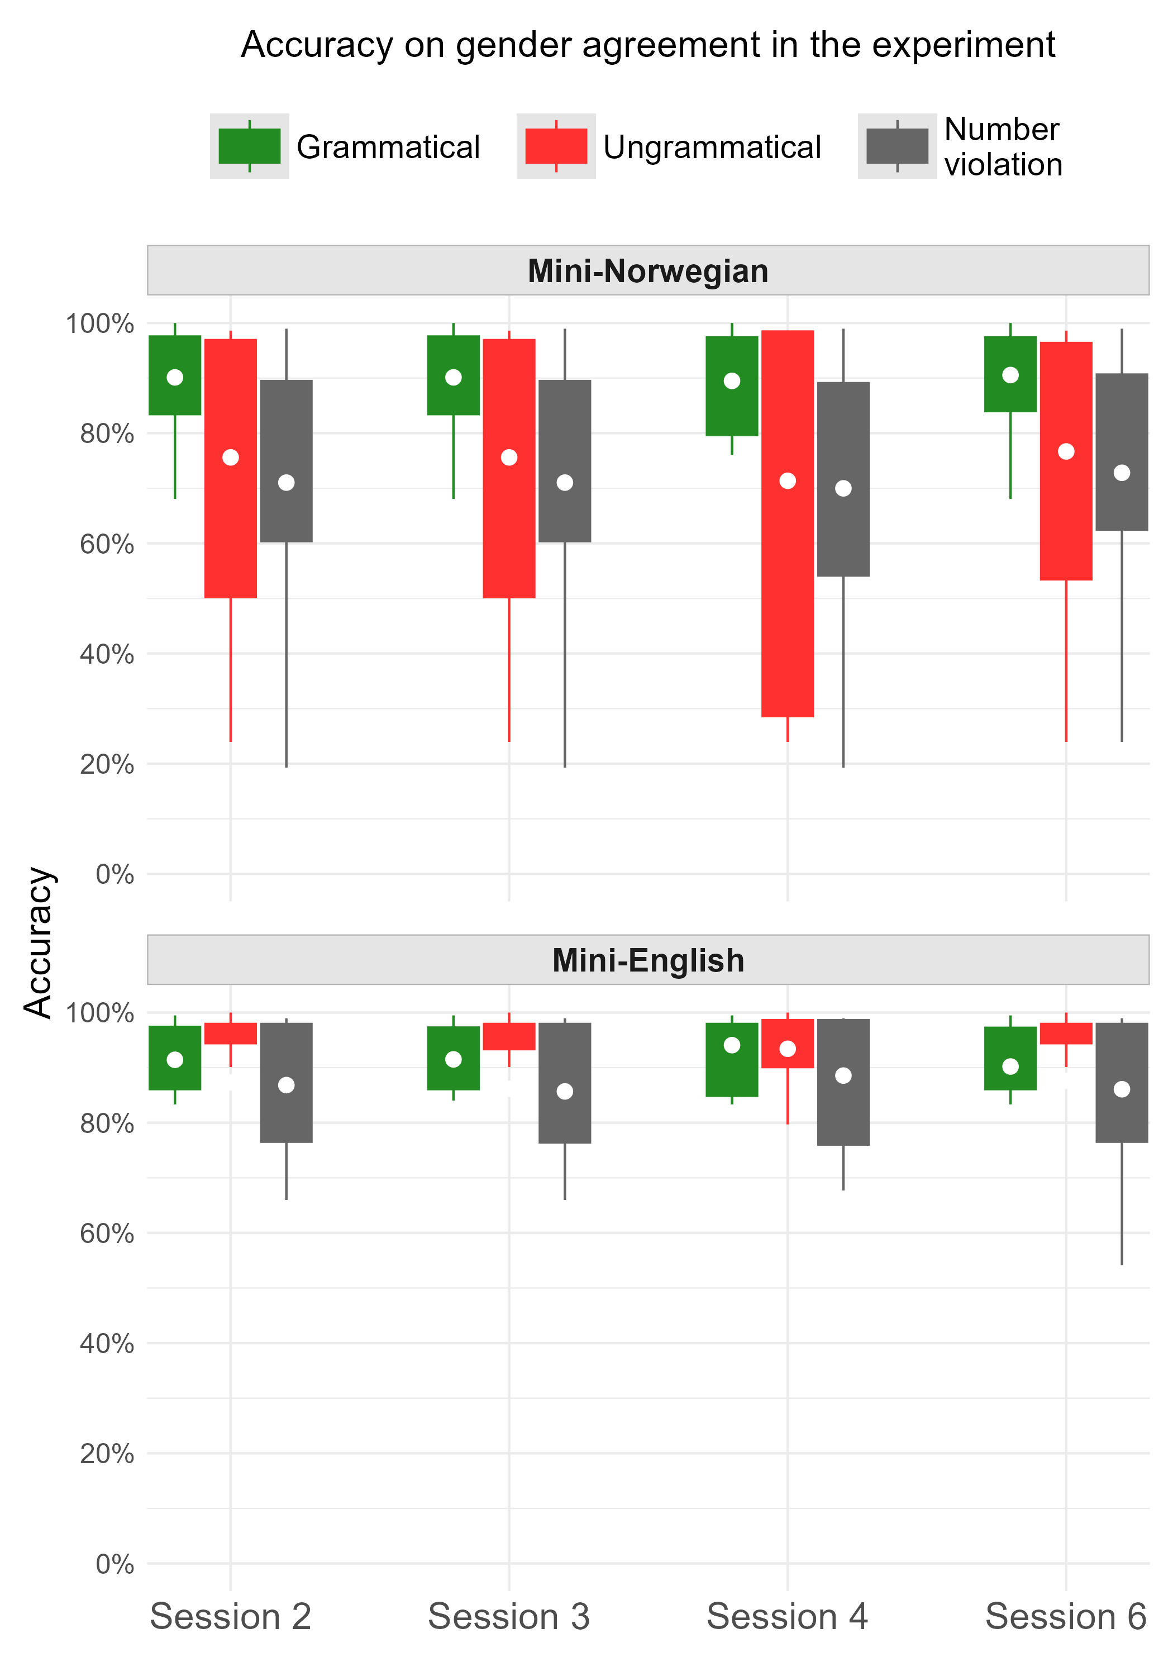

Slide 65
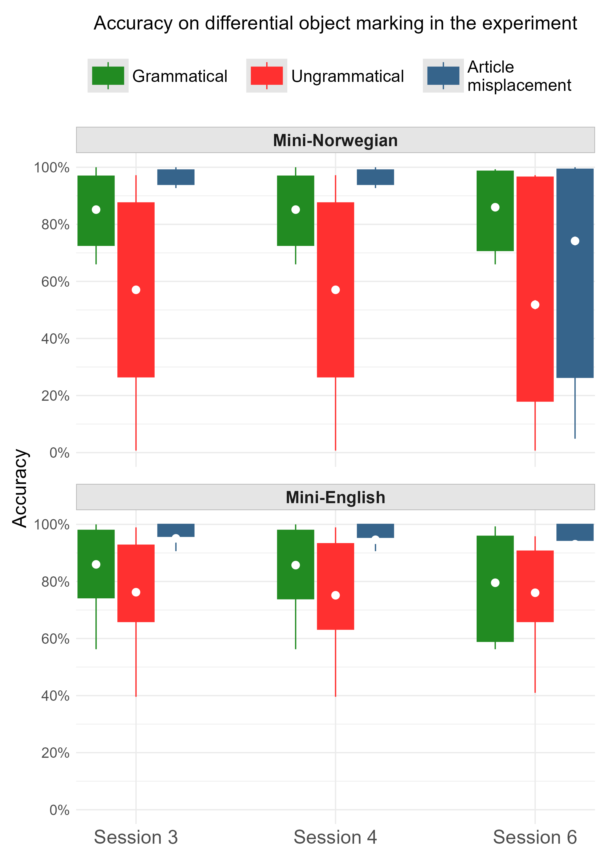

Slide 66
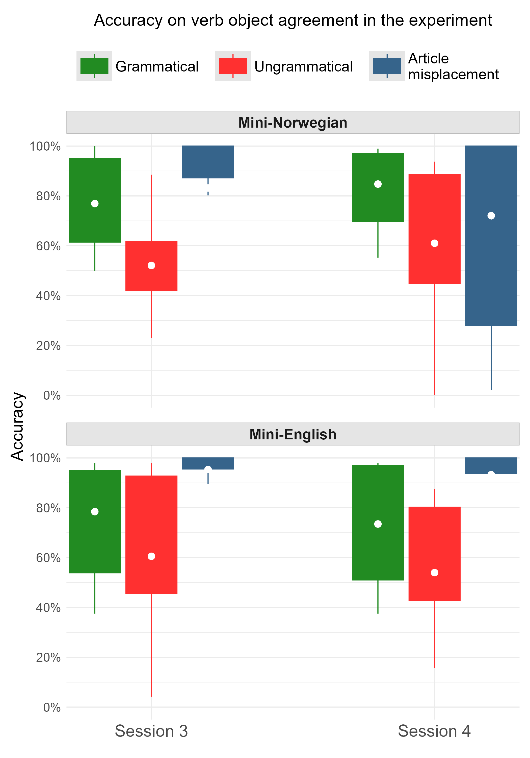

Slide 67
Event-related potentials
To be presented next…
Midline medial region: generally representative of other regions in the current data.
Per grammatical property
Per session

Slide 68
Gender agreement

Slide 69
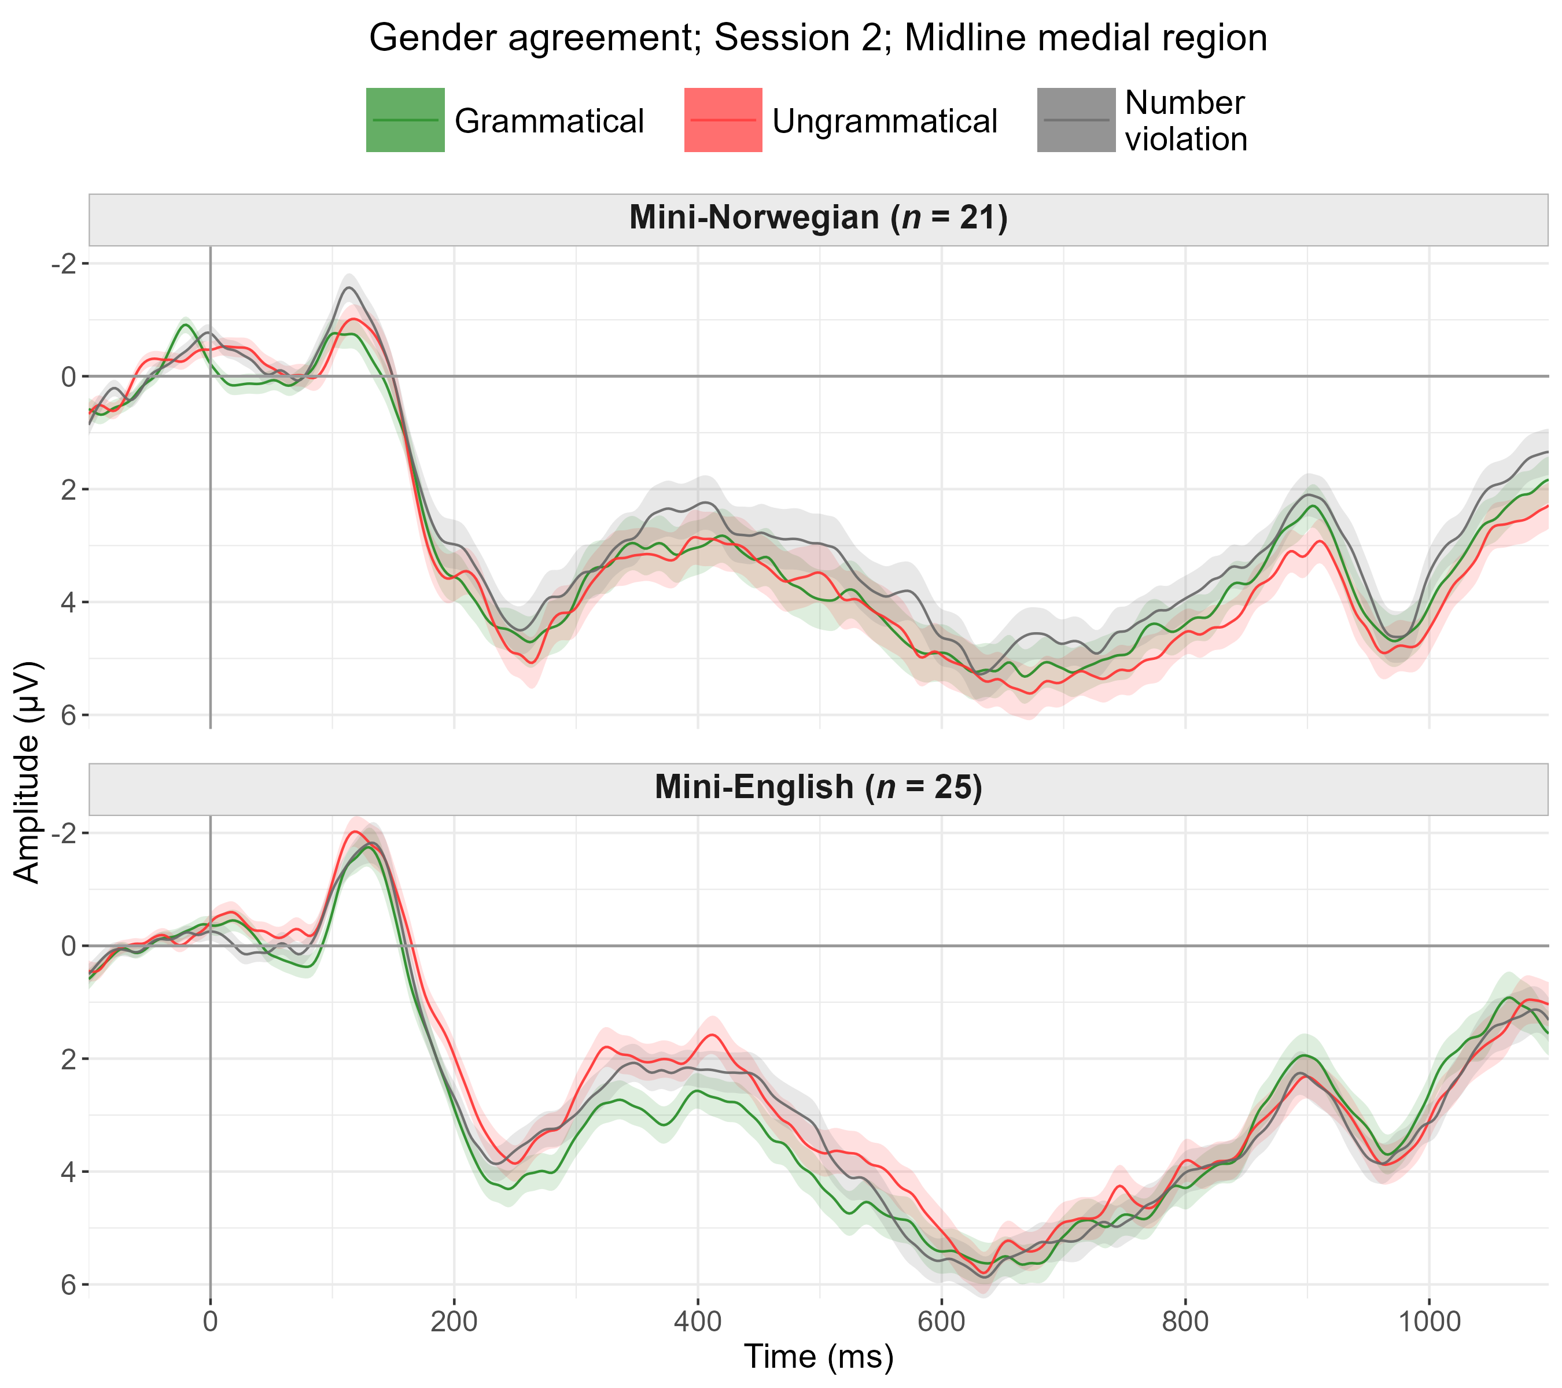

Slide 70
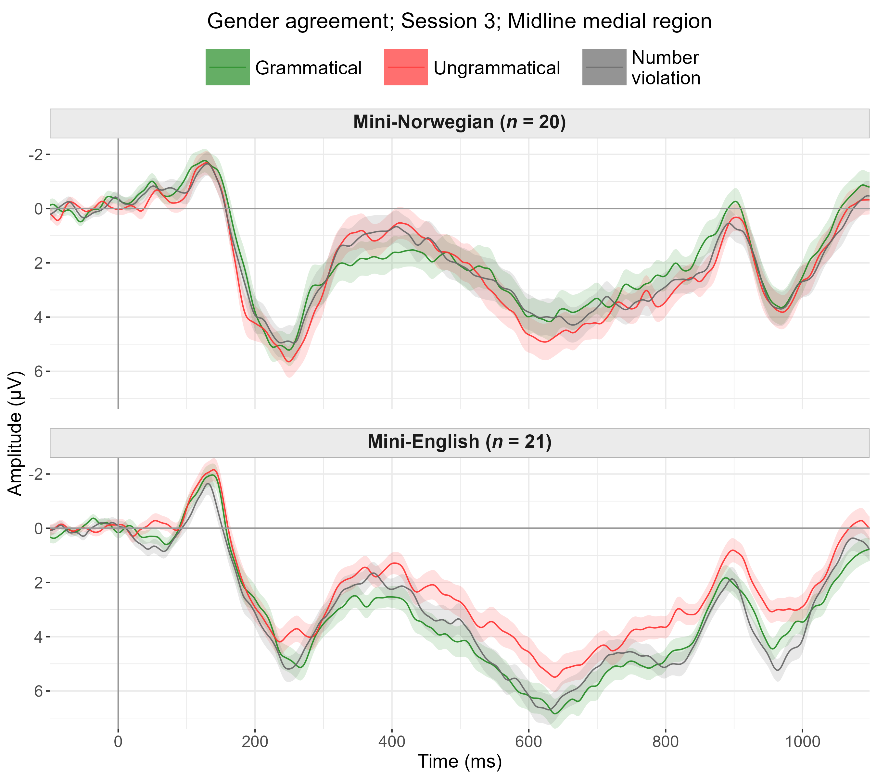

Slide 71
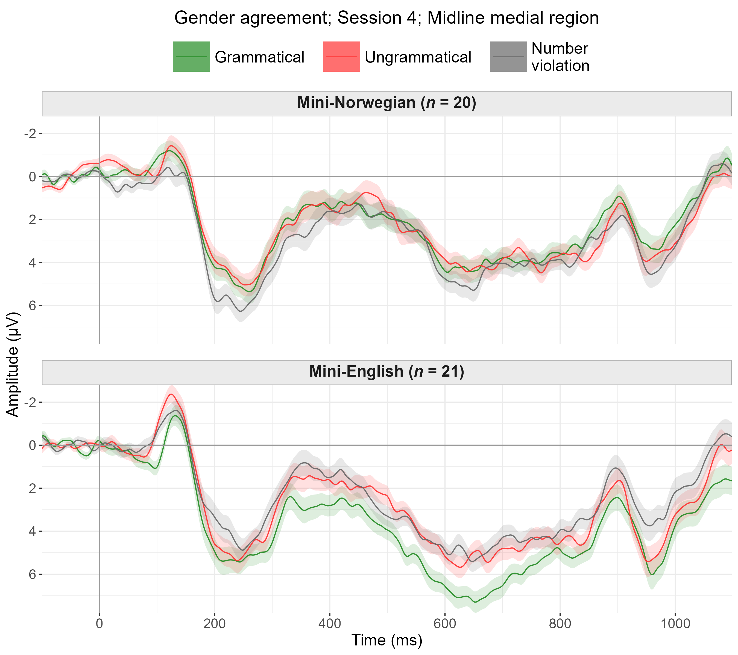

Slide 72
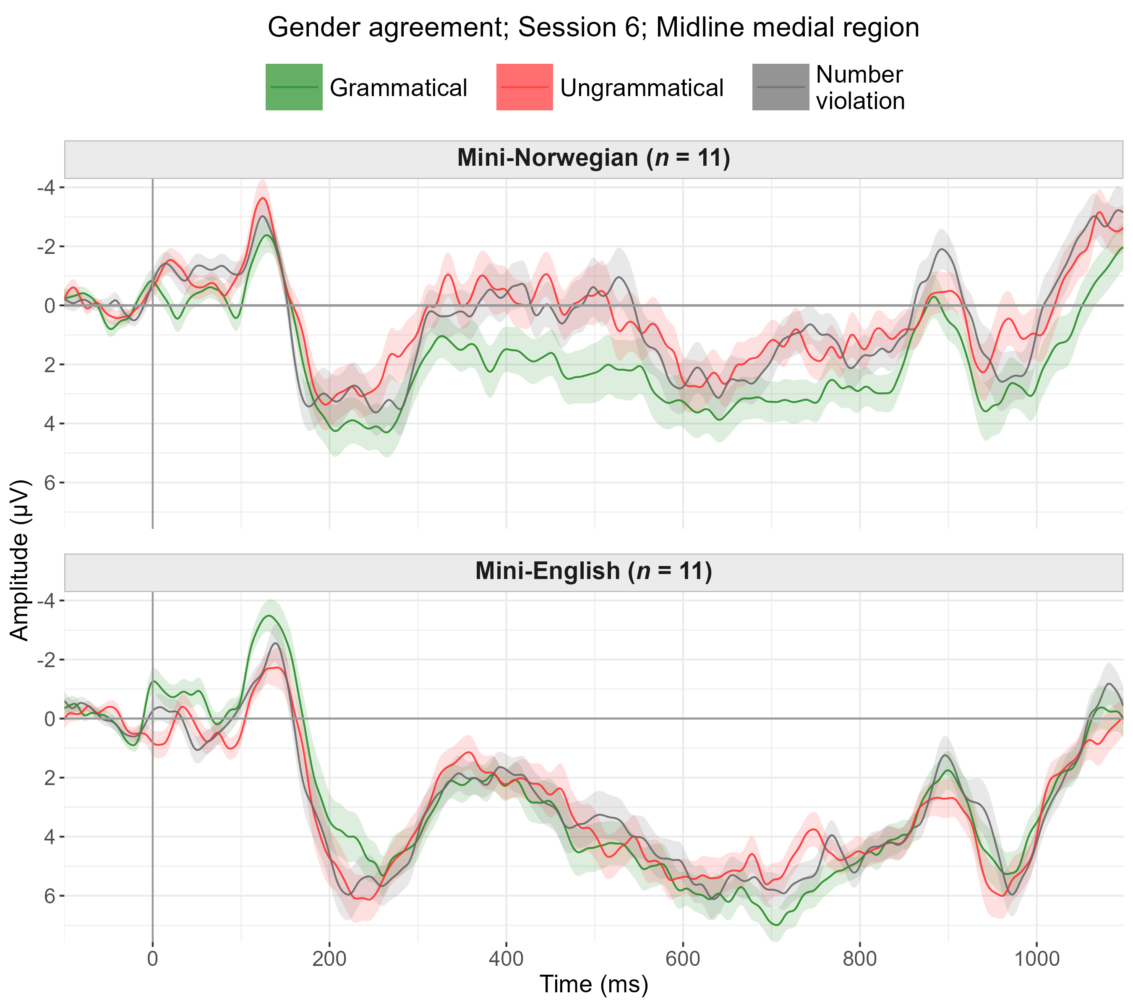

Slide 73
Differential object marking

Slide 74
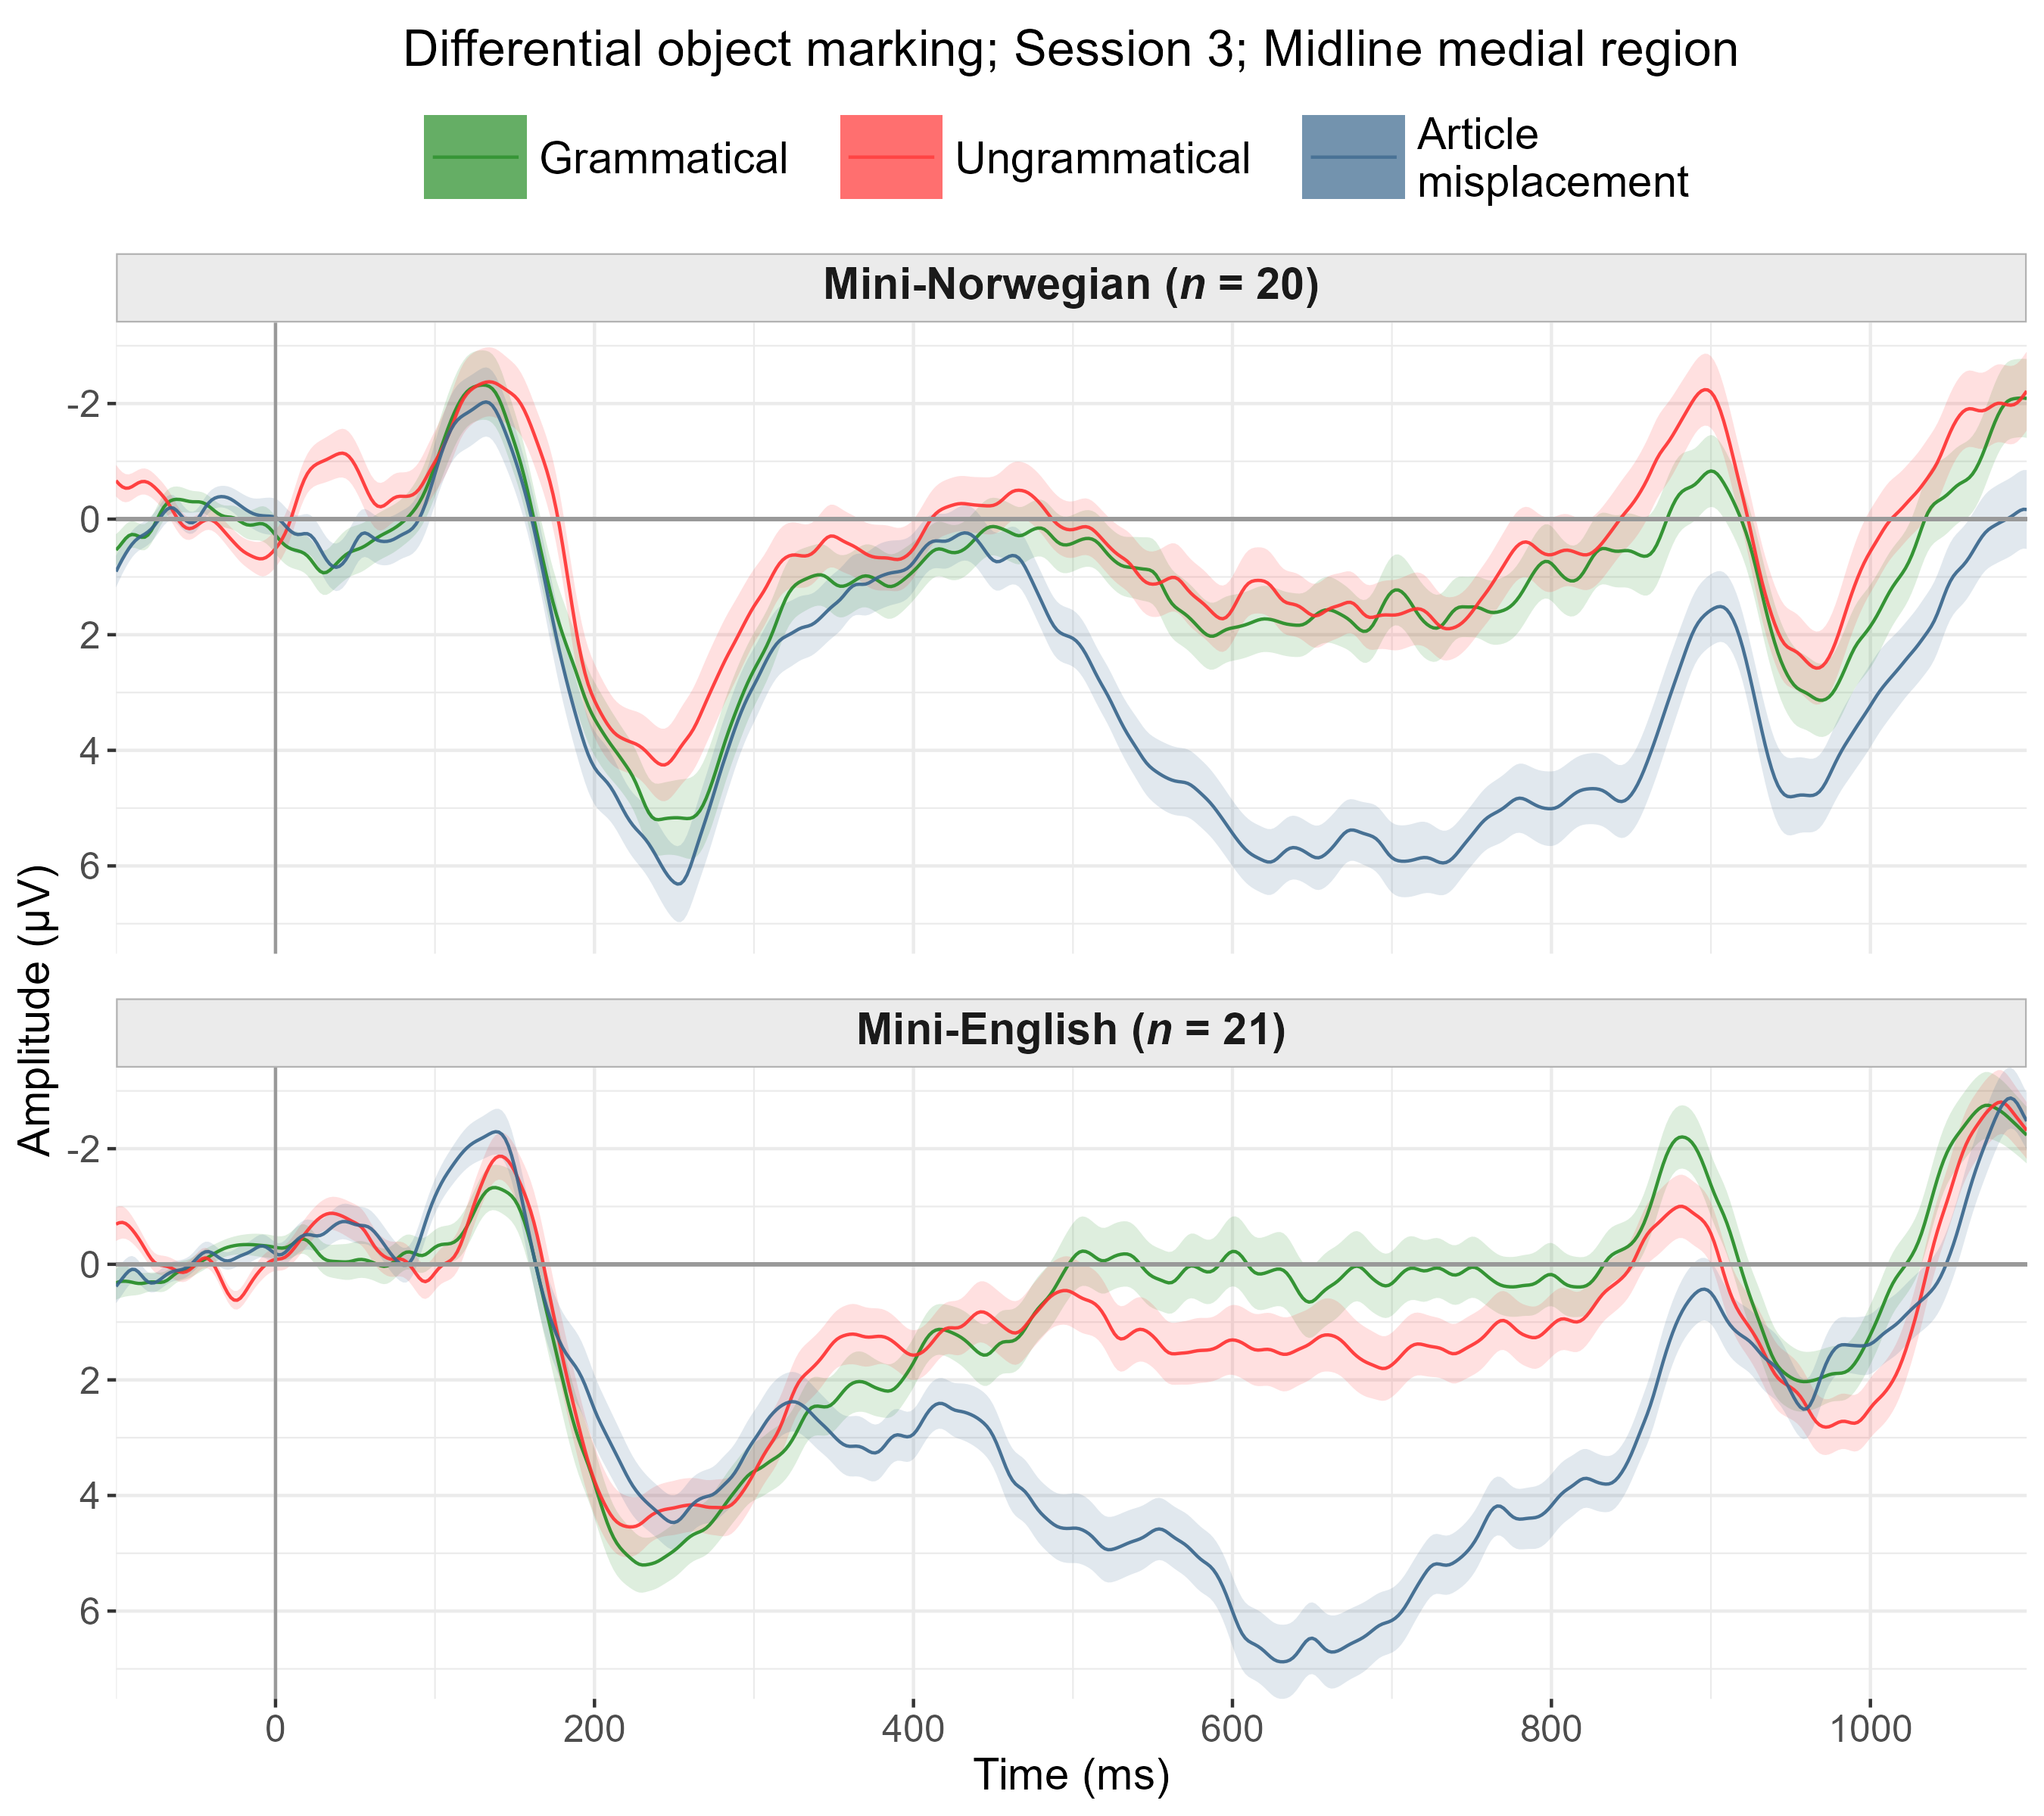

Slide 75
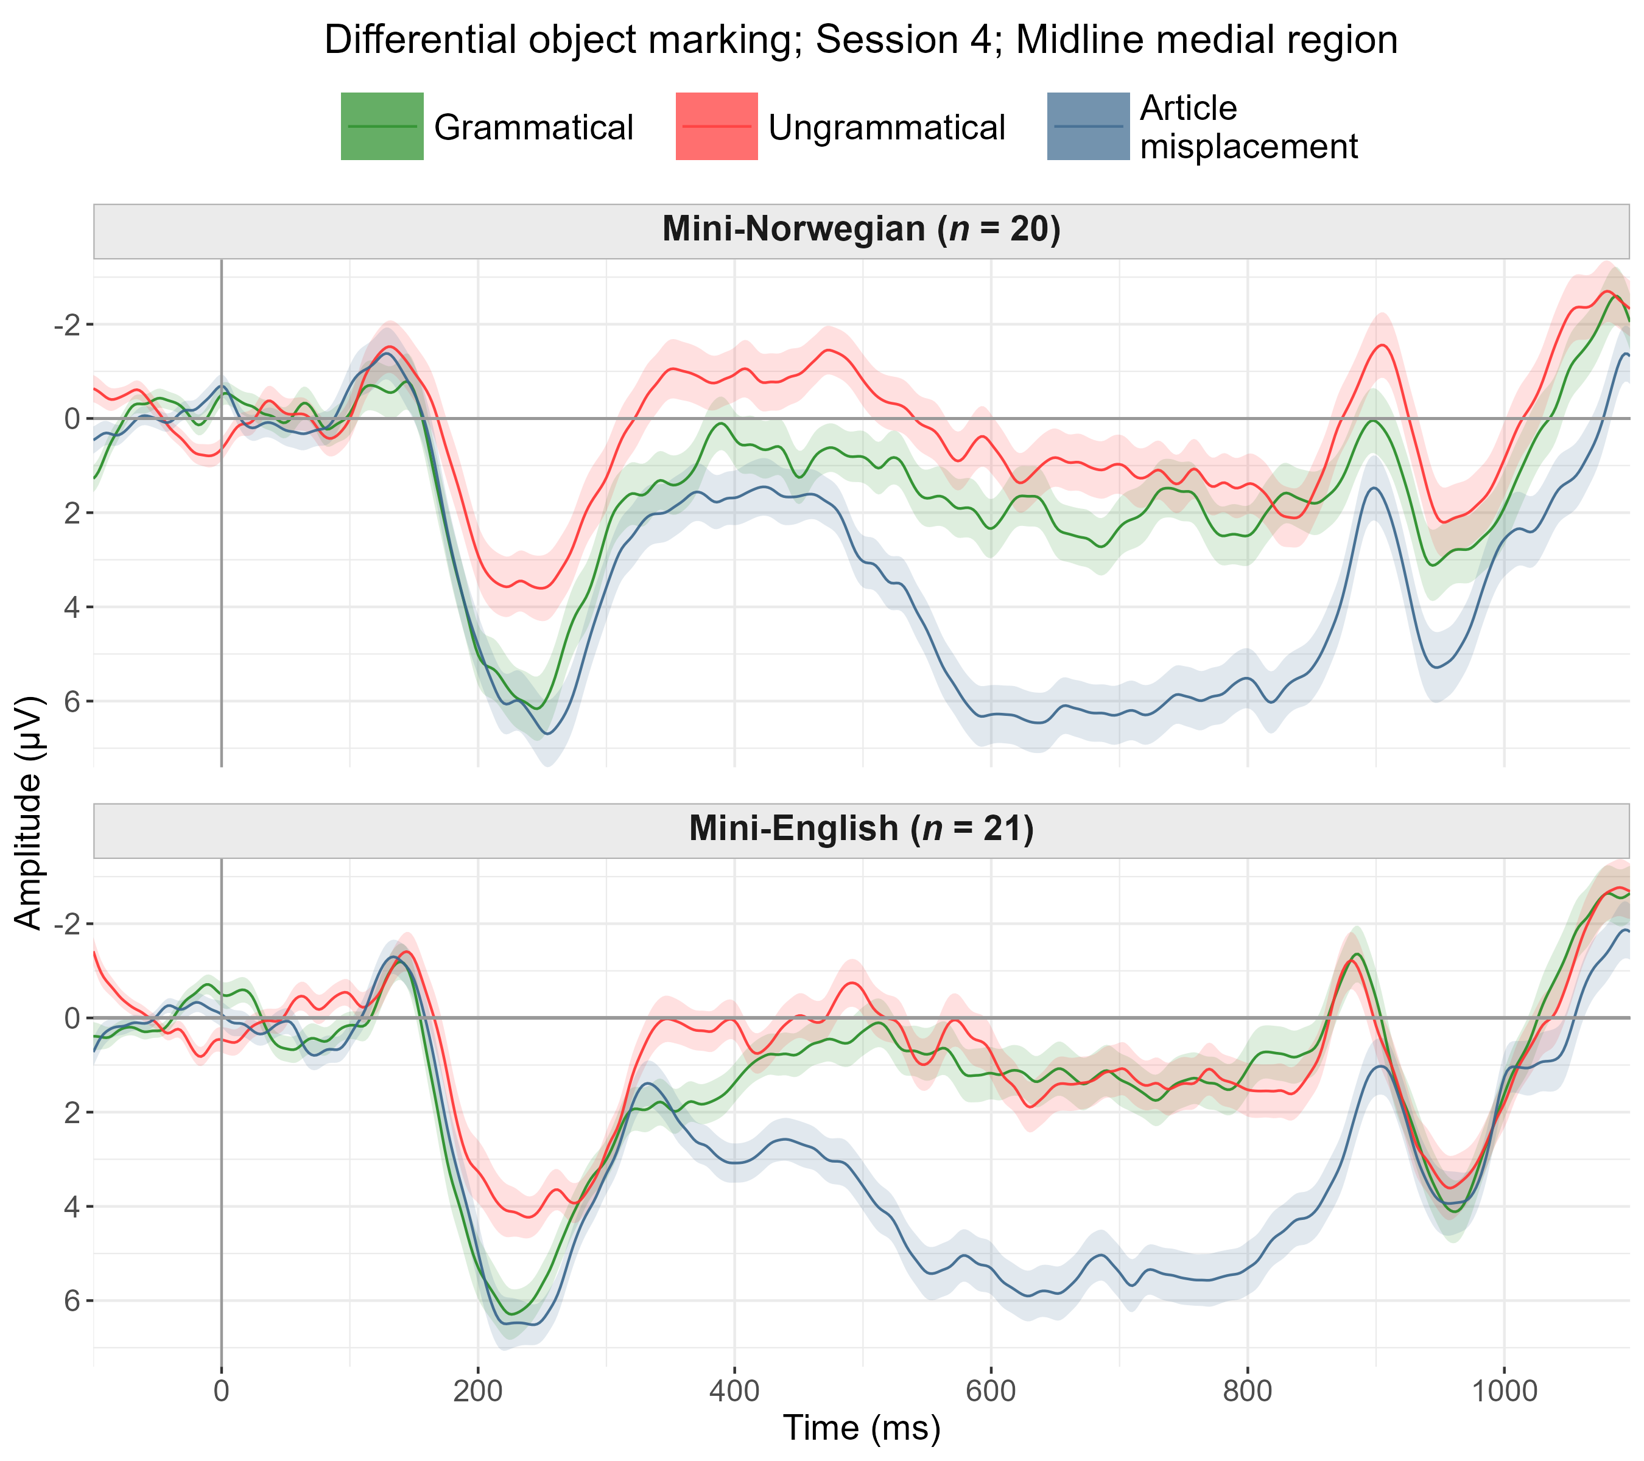

Slide 76
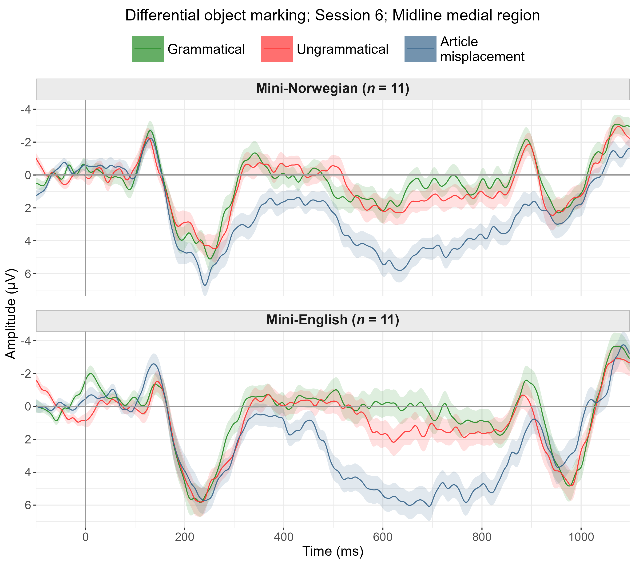

Slide 77
Verb-object agreement

Slide 78
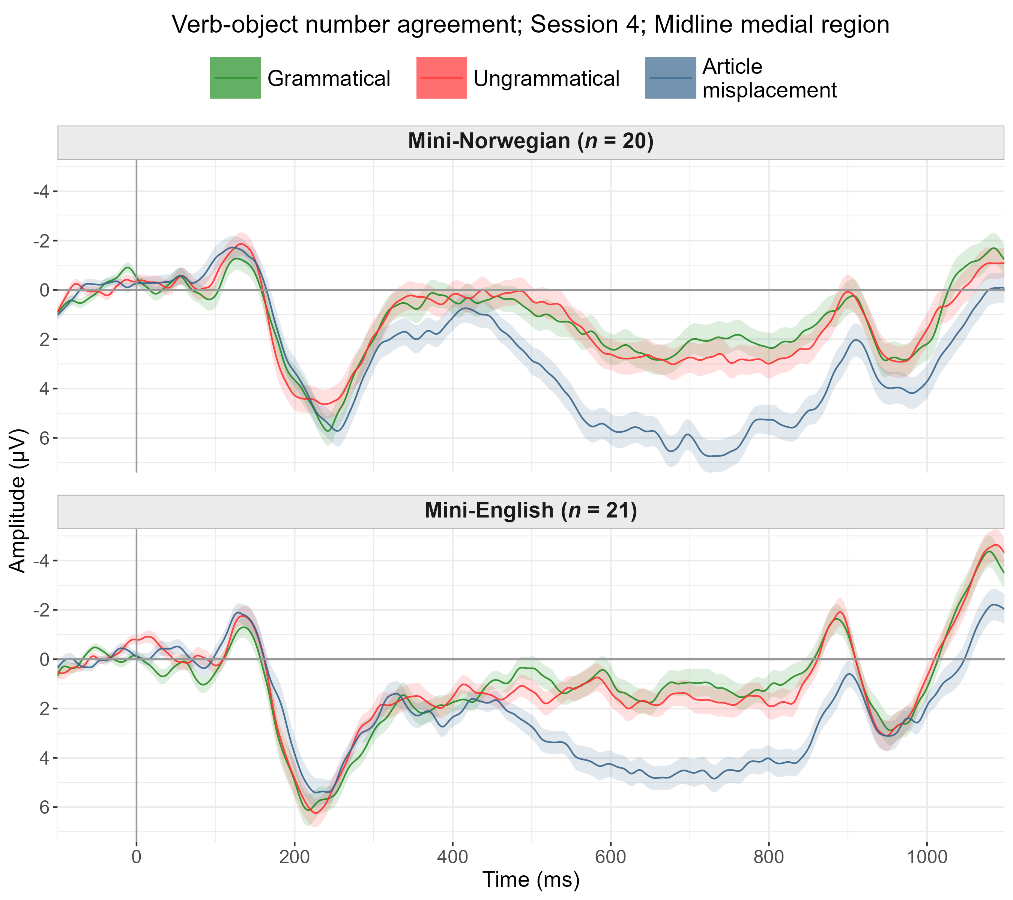

Slide 79
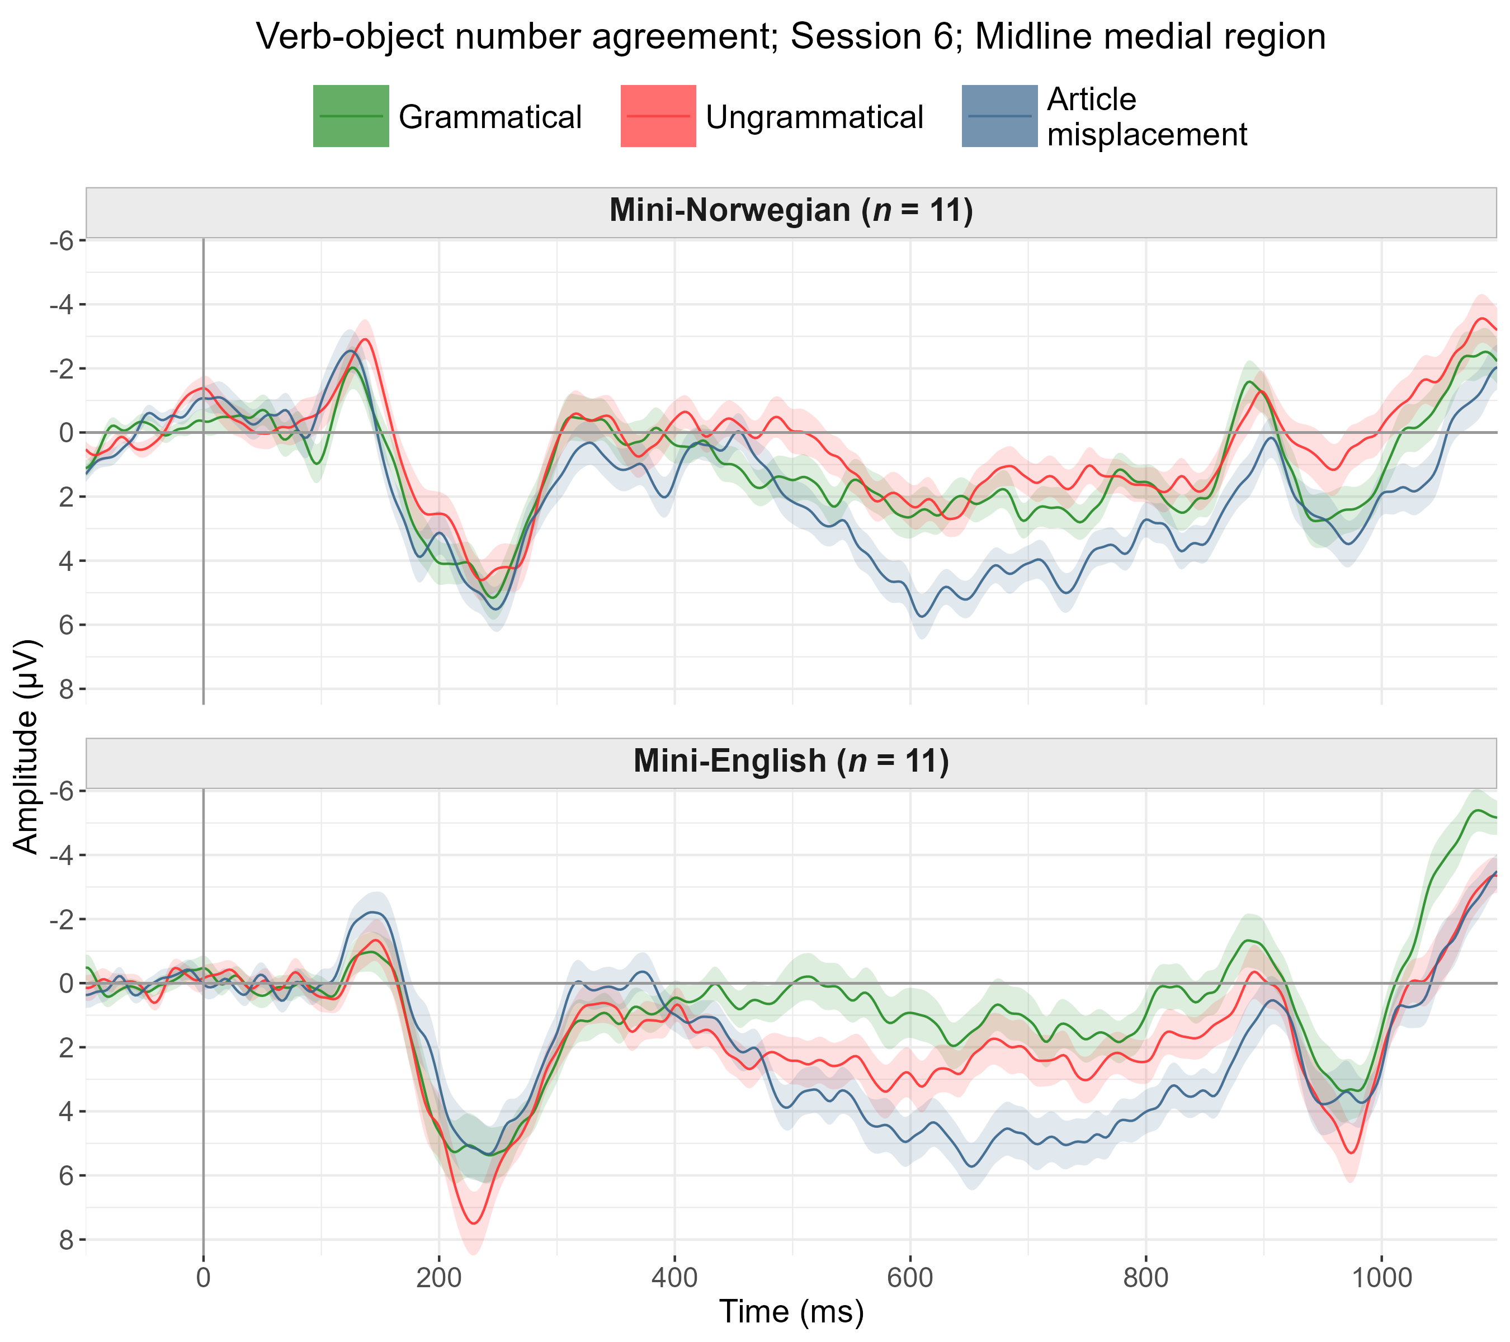

Slide 80
Analysis of ERPs for gender agreement
Data filtered to grammatical and ungrammatical conditions only.
Categorical predictors numerically recoded in logical ways.
Session: 0, 1, 2, 3
Grammaticality: -0.5, 0.5
All predictors z-scored.
Per time window (200–500, 300–600, 400–900 ms)
Per macro-region (lateral or midline electrodes)

Slide 81
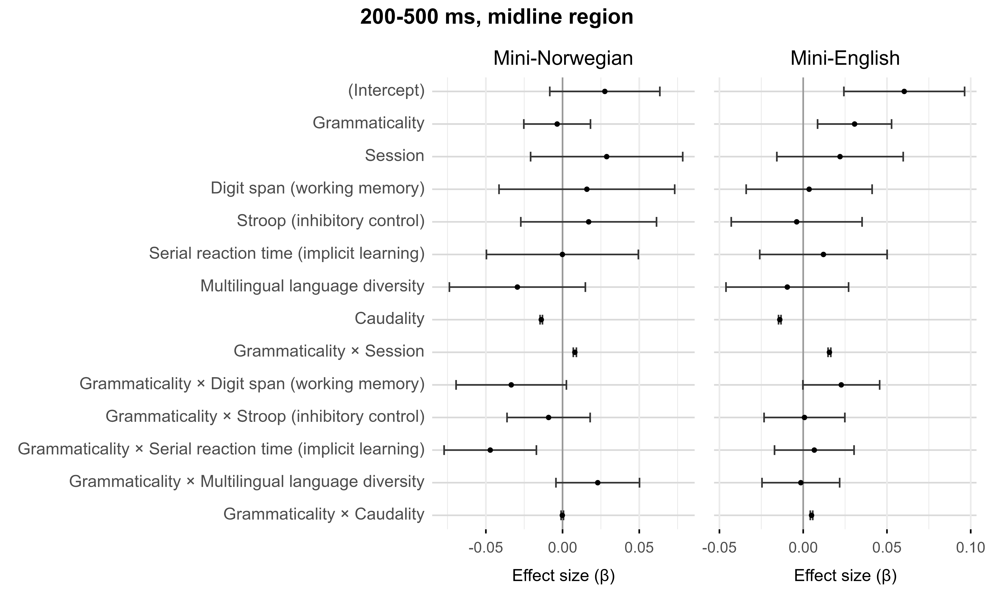

Slide 82
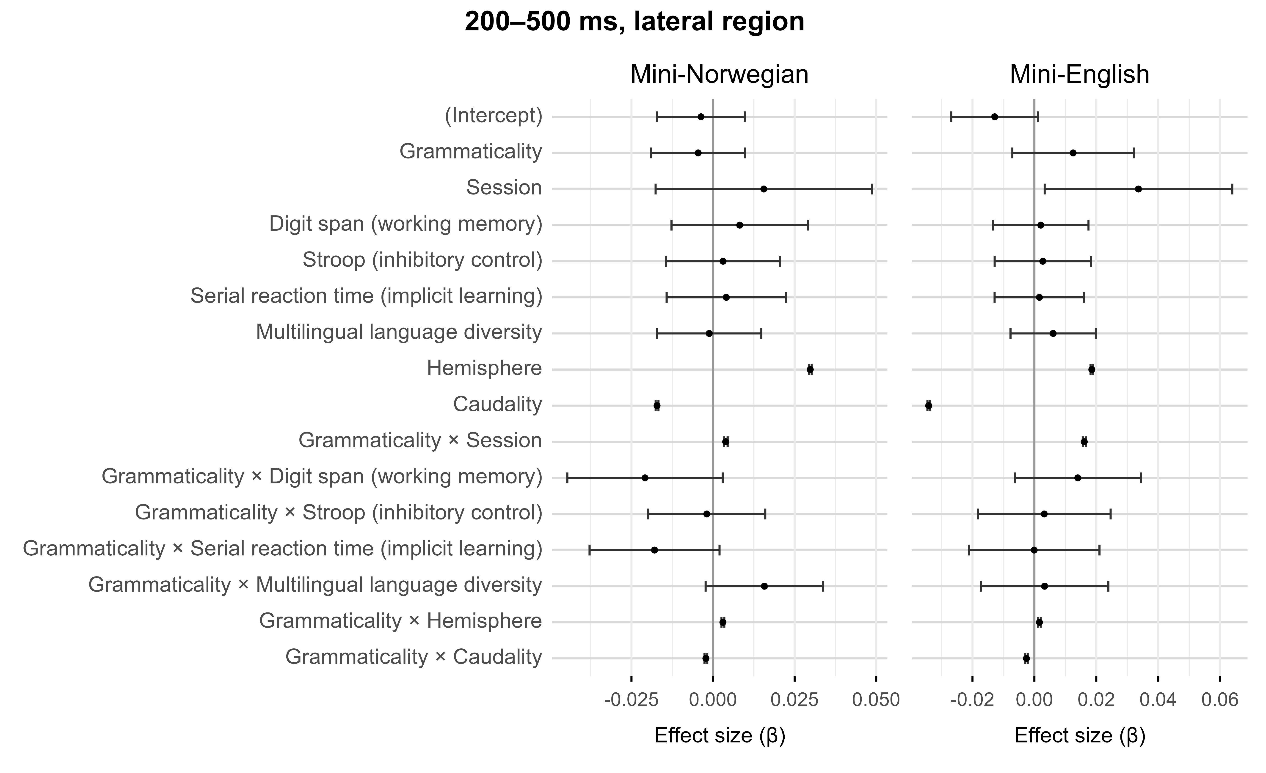

Slide 83


Slide 84
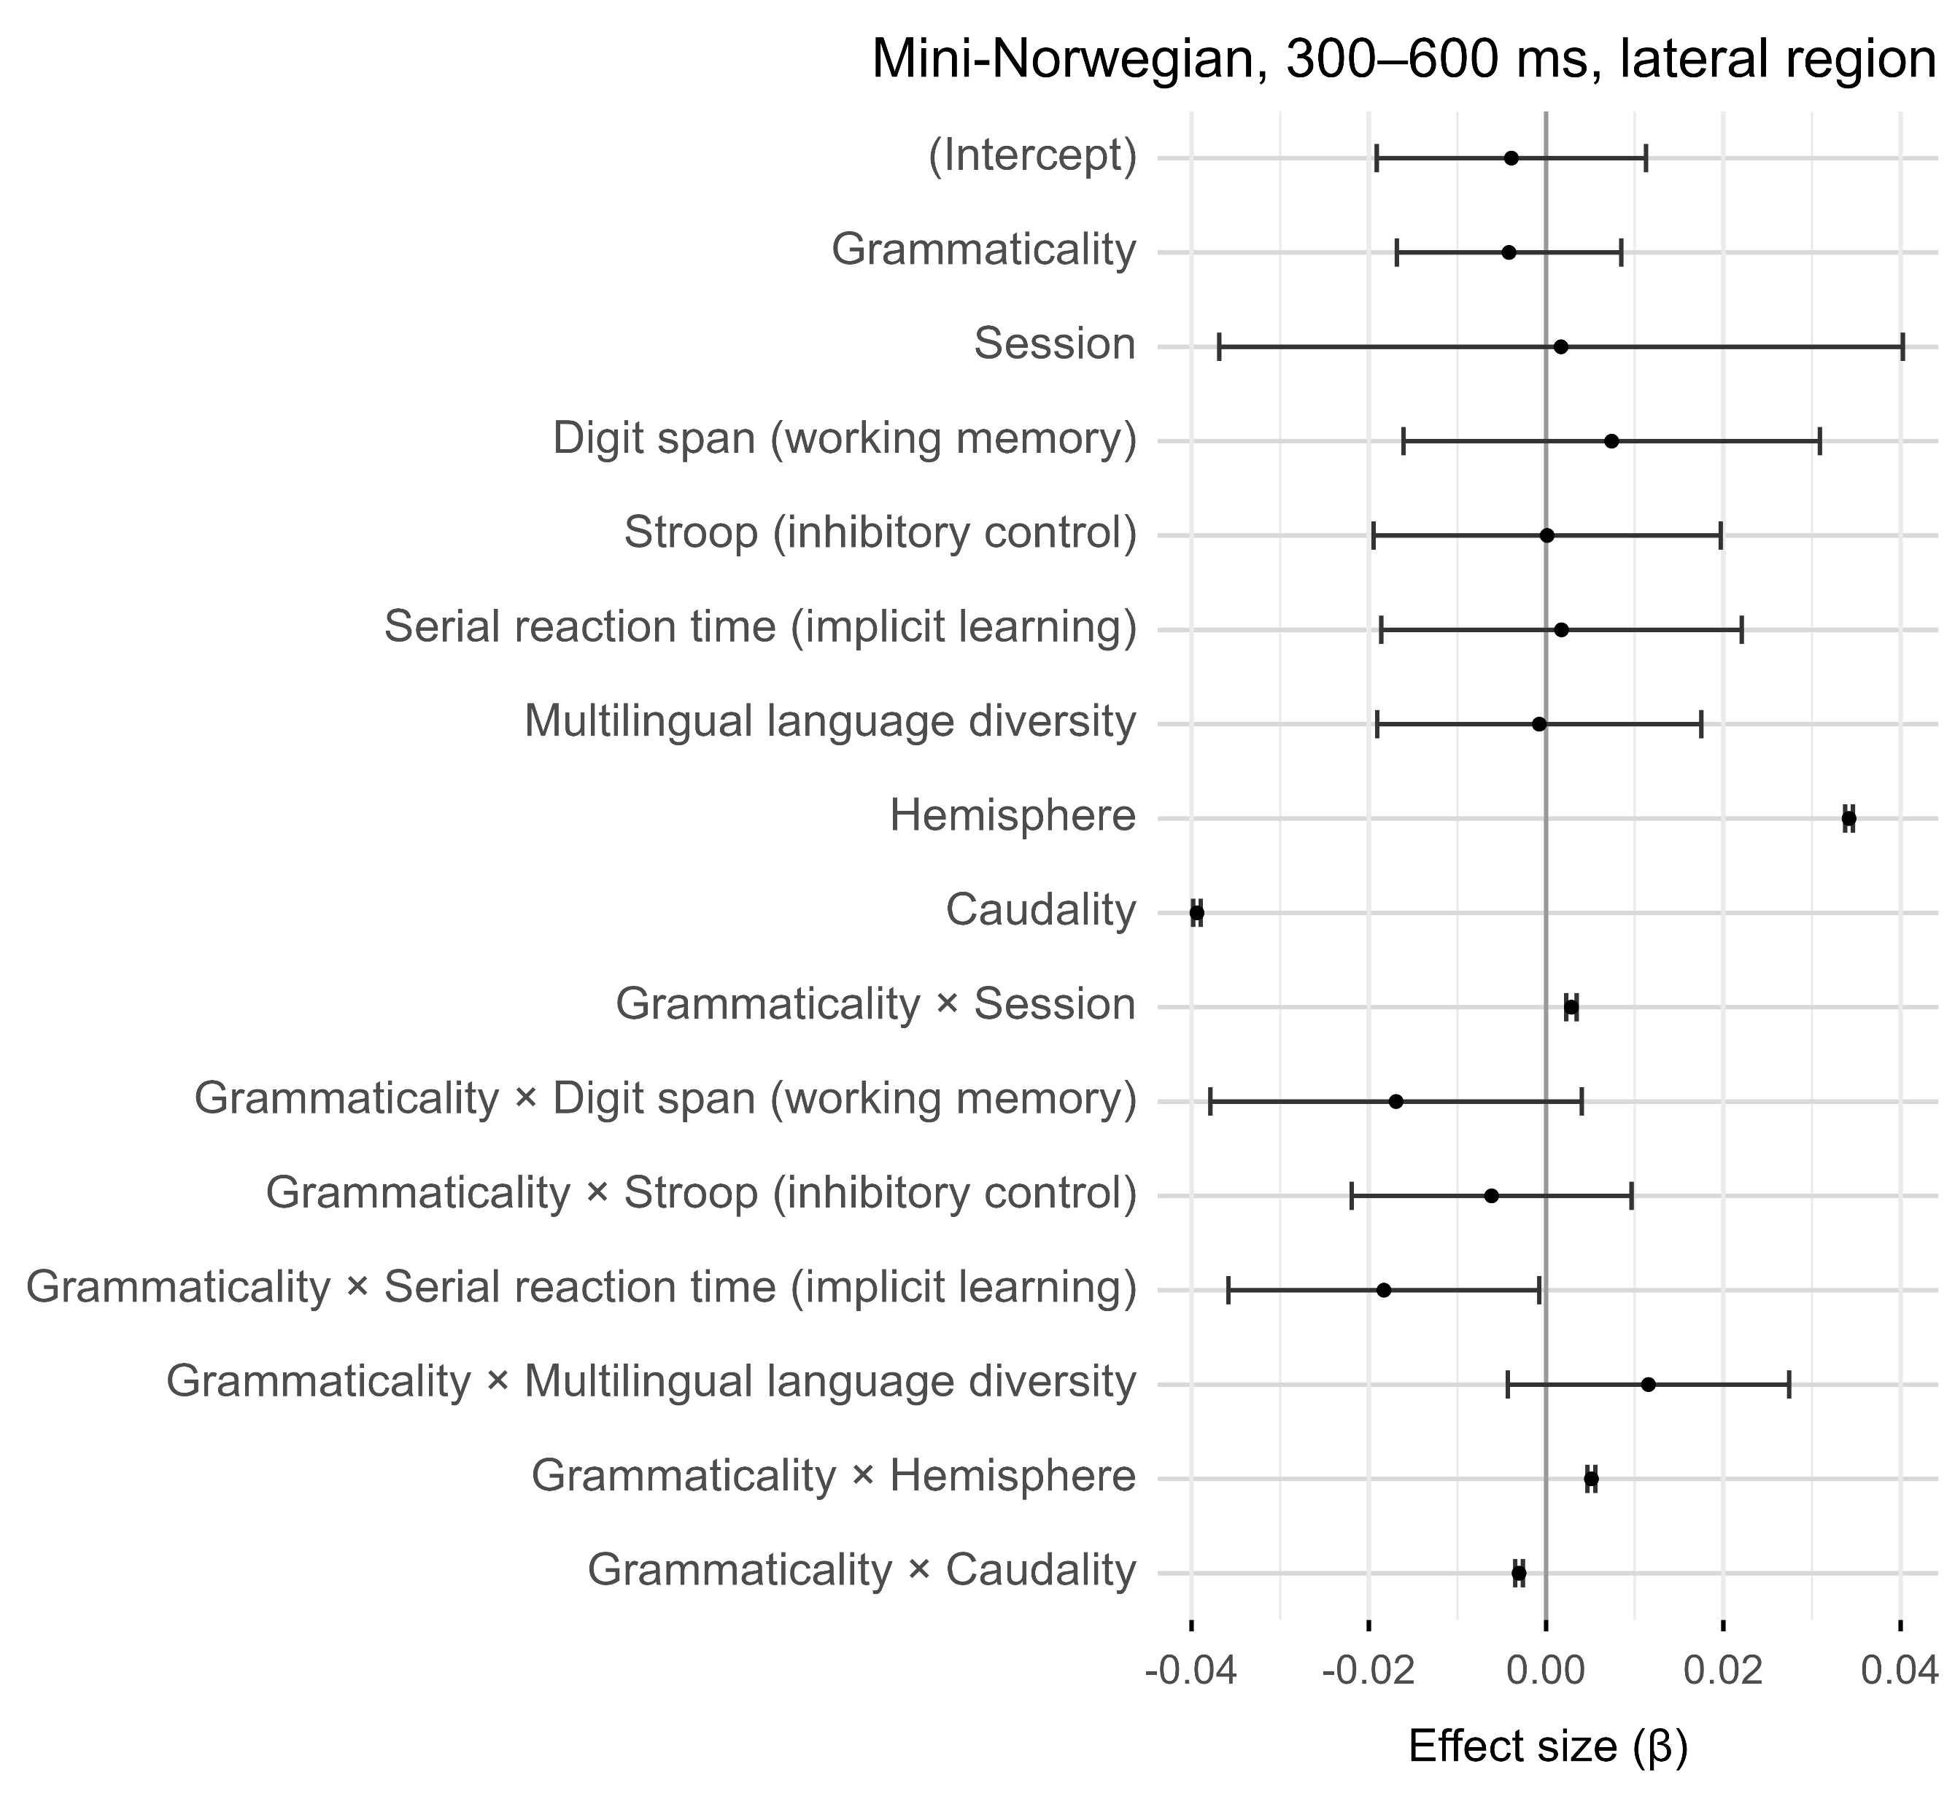

Temporary glitch in this Mini-English model

Slide 85
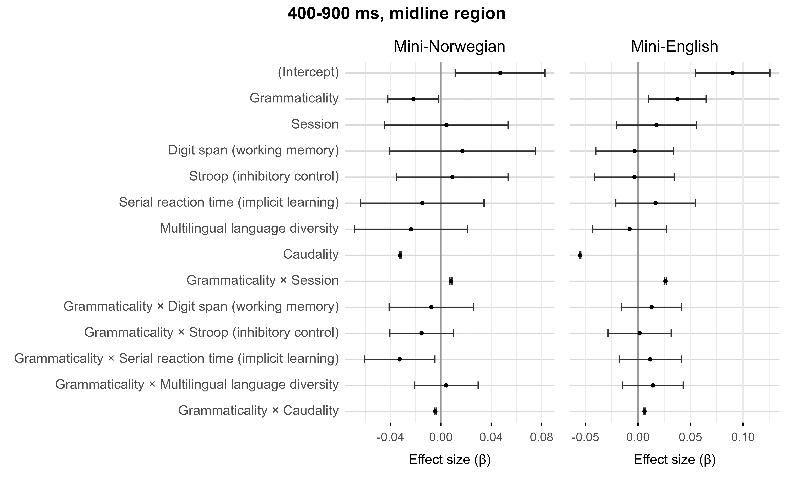

Slide 86
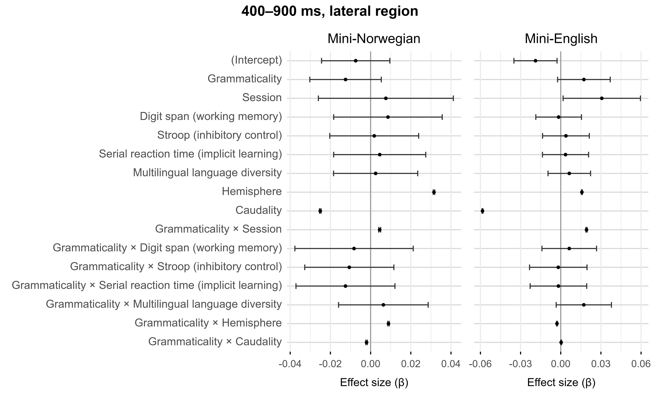

Slide 87
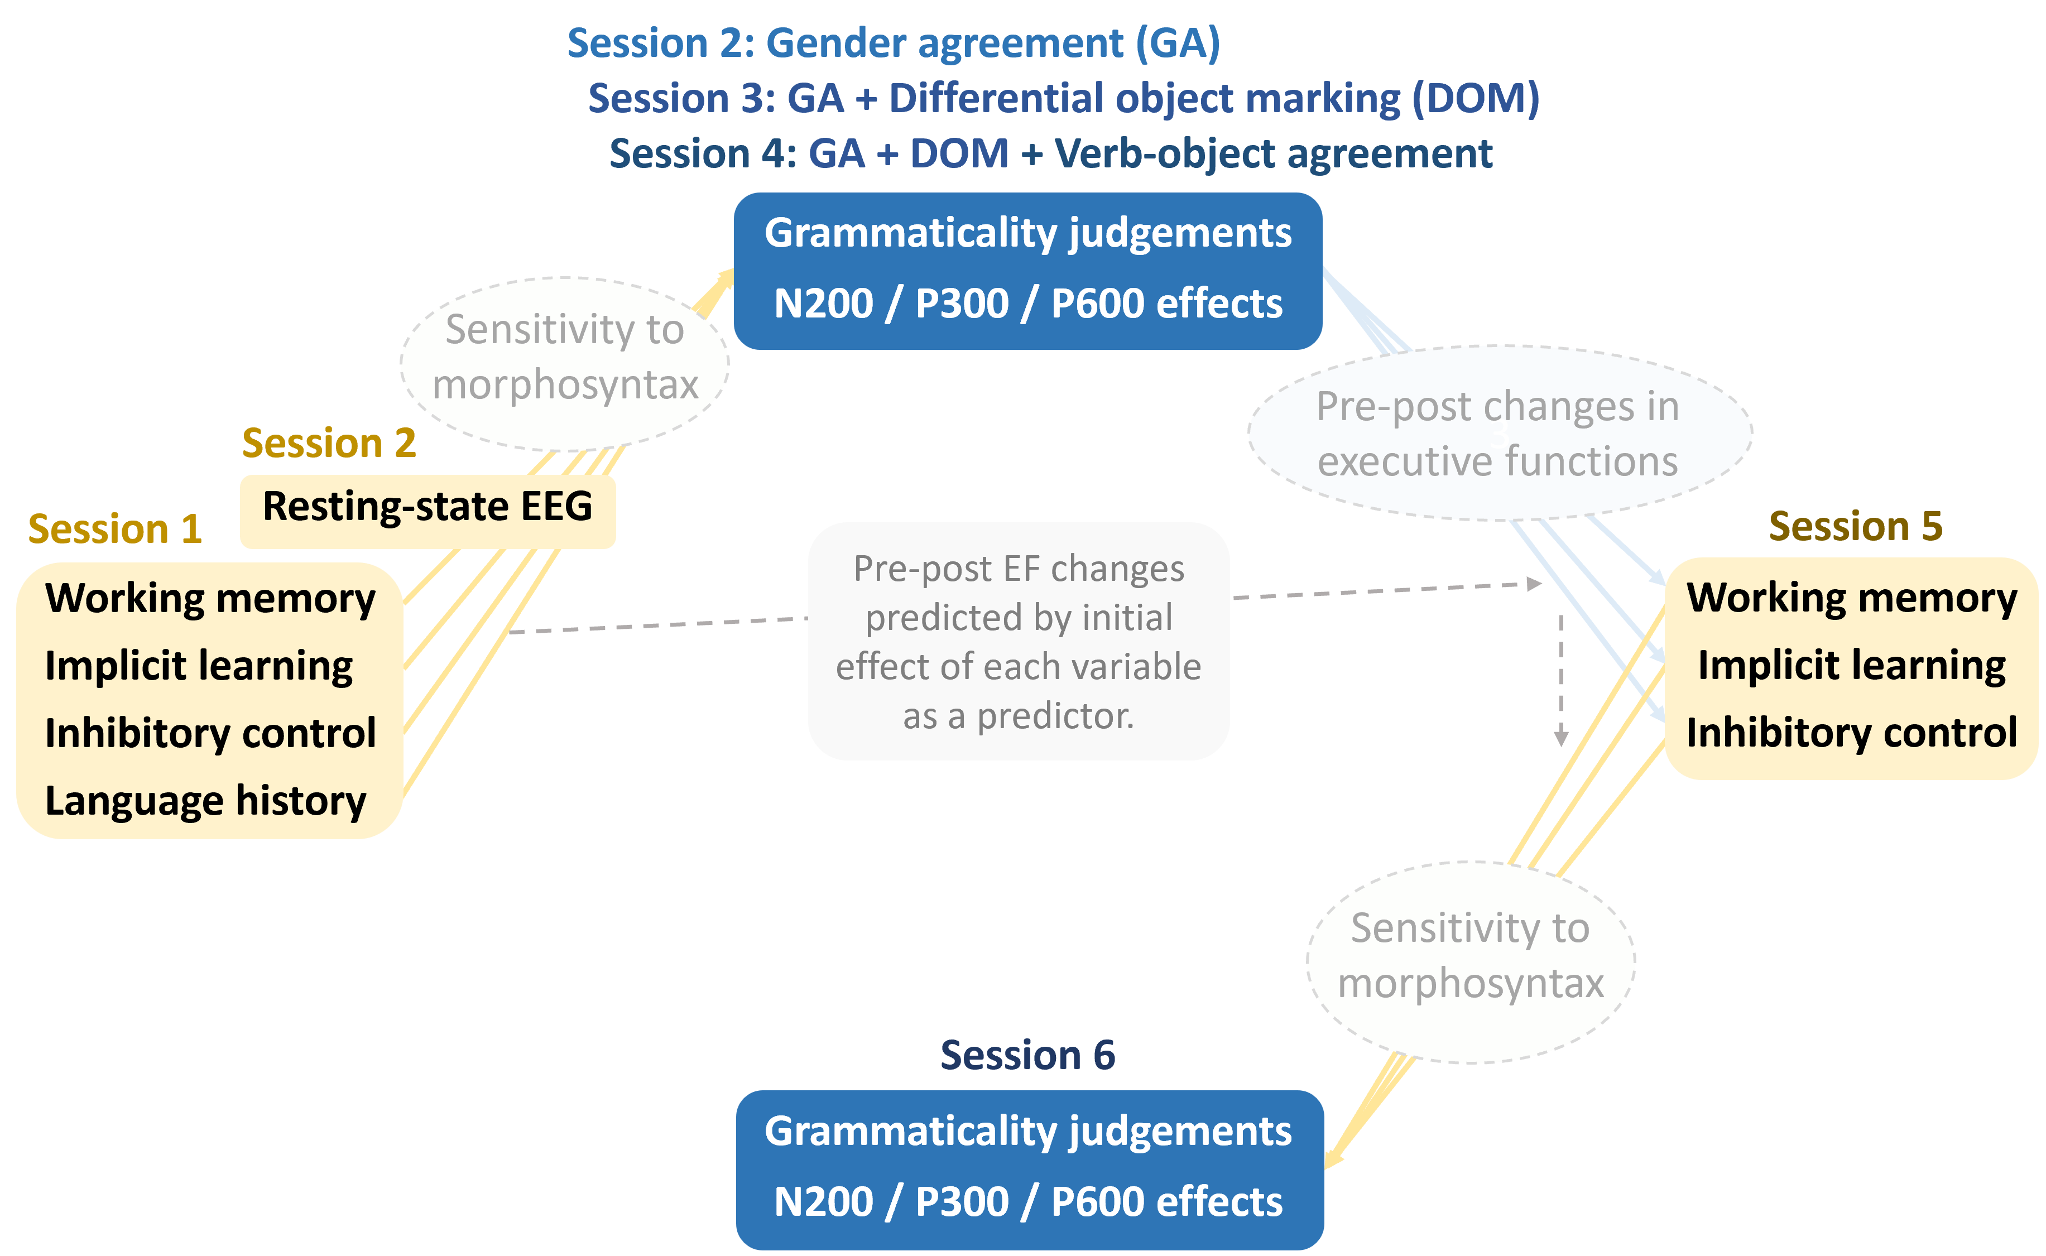
Further analyses and hypotheses

Slide 88
Refresher on the Sessions
Session 1. Individual differences (home-based session)
Working memory (digit span), selective attention (Stroop) and implicit learning (serial reaction time)
Language History Questionnaire (LHQ3; Li et al., 2020)
+ 1 week: Session 2. Gender agreement
Session begins with resting-state EEG (eyes-open, eyes-closed counterbalanced across participants)
+ 1 week: Session 3. Differential object marking + Gender agreement
Training only in the new property
Experiment part contains both properties intermixed
+ 1 week: Session 4. Verb-object agreement + Differential object marking + Gender agreement
Same mechanism as in the previous session
Session ends with resting-state EEG (eyes-open, eyes-closed counterbalanced across participants)
+ 1 week: Session 5. Retest of executive functions (home-based session)
+ 4 months: Session 6. Retest of all grammatical properties
Session ends with control tests on the relevant properties in the natural languages

Slide 89
Executive functions and rs-EEG
Primarily methodological analyses focussed on longitudinal stability.
Analysed first as independent variables, and second as dependent variables.

Slide 90
Longitudinal role of executive functions and rs-EEG
Independent-variable analysis: longitudinal stability (i.e., test-retest reliability) of the variables (for similar analyses, see Fuhs et al., 2014; Samuels et al., 2016; Swanson, 2015).
First analysis: longitudinal stability of the executive functions and rs-EEG on their own.
Second analysis: longitudinal stability of the executive functions and rs-EEG as predictors of language learning and morphosyntactic transfer over time.

Slide 91
Longitudinal effects on executive functions and rs-EEG
Dependent-variable analysis: whether cognitive enhancements in each executive function (incl. rs-EEG) induced by language training are consistent with the baseline role of each executive function (incl. rs-EEG).
Cognitive enhancements analysed relative to the effect of each executive function (incl. rs-EEG) as a predictor of language-learning performance following first exposure—i.e., in the first test on the artificial language.
Analysis intended to increase the methodological basis for the selection of measures to study training-induced cognitive enhancements (see Grossmann et al., 2023; Kliesch et al., 2022; Meltzer et al., 2023).
Pre-post effects not analysed in absolute terms due to lack of control group (Sala & Gobet, 2017).

Slide 92
Language learning: Analyses and hypotheses

Slide 93
Language learning
Hypothesis 1: greater executive functions (overall, incl. rs-EEG) → better language learning
Exploratory analysis: relative importance of the four executive function measures
Hypotheses to be set a priori where possible
Hypothesis 2: greater executive functions (overall, incl. rs-EEG) → greater longitudinal improvements in language learning due to better accumulation of knowledge
Hypothesis 3: longitudinal retests in the grammatical properties → better language learning
Minor caveat: limited variation due to accuracy threshold in the tests. That is, participants can only do the experiment if they pass the test with a minimum of 80%.

Slide 94
Morphosyntactic transfer: Analyses and hypotheses

Slide 95
Standardised numeric predictions
Effect sizes standardised between 0 and 10
Visualisation of numerous comparisons across conditions and models
Pave the way towards computational models with numeric predictions

Slide 96
Standardised numeric predictions
Effect sizes standardised between 0 and 10
Visualisation of numerous comparisons across conditions and models
Pave the way towards computational models with numeric predictions
Norway site predictions
Property | Artificial lang. | L2SFM | CEM | LPM | TPM
 |  | L2 default | prop. by prop. | prop. by prop. | full transfer
Gender agreement | Mini-Norwegian | 0 | 10 | 5-10 | 10
 | Mini-English | 10 | 10 | 0-5 | 0-2
Differential object marking | Mini-Norwegian | 0-3 | 0-3 | 0-2 | 0-2
 | Mini-English | 0-3 | 0-3 | 0-3 | 0-3
Verb-object number agreem. | Mini-Norwegian | 0-3 | 3 | 0-6 | 0-5
 | Mini-English | 0-3 | 3 | 0-3 | 0-3

Slide 97
Spain site predictions
Property | Group | Artificial lang. | L2SFM | CEM | LPM | TPM
 |  |  | L2 default | prop. by prop. | prop. by prop. | full transfer
Gender agreement | L1 Eng, L2 Spa | Mini-Spanish | 10? | 10 | 5-10 | 10
 | L1 Eng L2 Sp | Mini-English | 10? | 10 | 5-7 | 0
 | L1 Spa, L2 Eng | Mini-Spanish | 0 | 10 | 5-10 | 10
 | L1 Sp L2 Eng | Mini-English | 0 | 10 | 0-5 | 0
Differential object marking | L1 Eng, L2 Spa | Mini-Spanish | 8? | 8 | 5-8 | 8
 | L1 Eng L2 Sp | Mini-English | 8? | 8 | 0-5 | 0-2
 | L1 Spa, L2 Eng | Mini-Spanish | 0 | 8 | 5-8 | 8
 | L1 Sp L2 Eng | Mini-English | 0 | 8 | 0-5 | 0-2
Verb-object number agreement | L1 Eng, L2 Spa | Mini-Spanish | 0-5? | 0-3 | 0-4 | 0-3
 | L1 Eng L2 Sp | Mini-English | 0-5? | 0-3 | 0-2 | 0-2
 | L1 Spa, L2 Eng | Mini-Spanish | 0-3 | 0-3 | 0-4 | 0-3
 | L1 Sp L2 Eng | Mini-English | 0-3 | 0-3 | 0-3 | 0-2

Slide 98
Executive functions and morphosyntactic transfer
Hypothesis 1: greater executive functions (overall, incl. rs-EEG) → greater precursors of transfer (N2, P3)
Hypothesis 2: greater executive functions (overall , incl. rs-EEG) → greater signatures of transfer (P600)

Slide 99
Longitudinal effects in morphosyntactic transfer
Hypothesis 1: any signatures of transfer (esp. P600) more likely to occur in later sessions.
Hypothesis 2: any signatures of transfer (esp. P600) should persist in subsequent sessions.

Slide 100
Thank you
References and further information available upon request.
Questions and feedback very welcome.

